Slide 1
Sprint 4
Music Trivia Web-based Game

Slide 2
Contents
What I did?
What’s next?

Slide 3
What I did?
Deploy backend to Kubernetes
Add authentication and authorization in frontend
Create the initial risk analysis document
Create GDPR Compliance document
Add sonarqube to pipeline

Slide 4
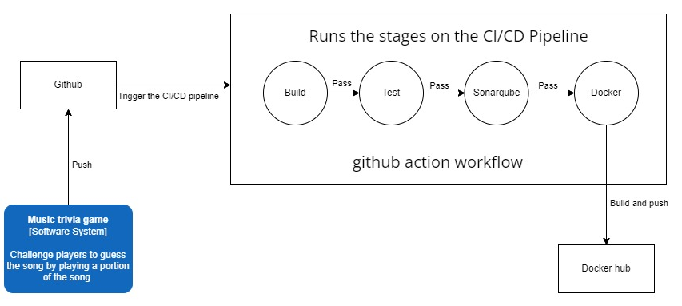
CI pipeline

Slide 5
Show
Initial risk analysis document
GDPR compliance document

Slide 6
Sprint 5
To do list
Learning outcome 3 Scalable architecture
1. Validate non-functional requirements, for example performance, stress testing, and database performance test.
2.Update system architecture diagram to outline the communication to micro-service to micro-service.
Learning outcome 4 DevOps
1. Add other tools to the pipeline like security test tool, and other tools.
Learning outcome 5 Cloud native
1. Deploy project to cloud.
2. Intergrade 3rd party cloud service, like functional service.
Learning outcome 6 Security
1. Implement “How are you going to validate your security risk in the risk analysis”.

Slide 7

Thank you

